Slide 1





MediPulse
PRESENTATION
MediPulse
The Future of Healthcare Starts with MediPulse

Slide 2




Medipulse
Agenda
Introduction
Our Purpose
Core Features
Technologies Used
Meet the team
Demo
References & Contacts

Slide 3

Medipulse
What is
MediPulse?
MediPulse is a unified digital health platform that brings together doctor search, medication tracking, appointment booking, and AI-powered assistance — all in one place.

Slide 4
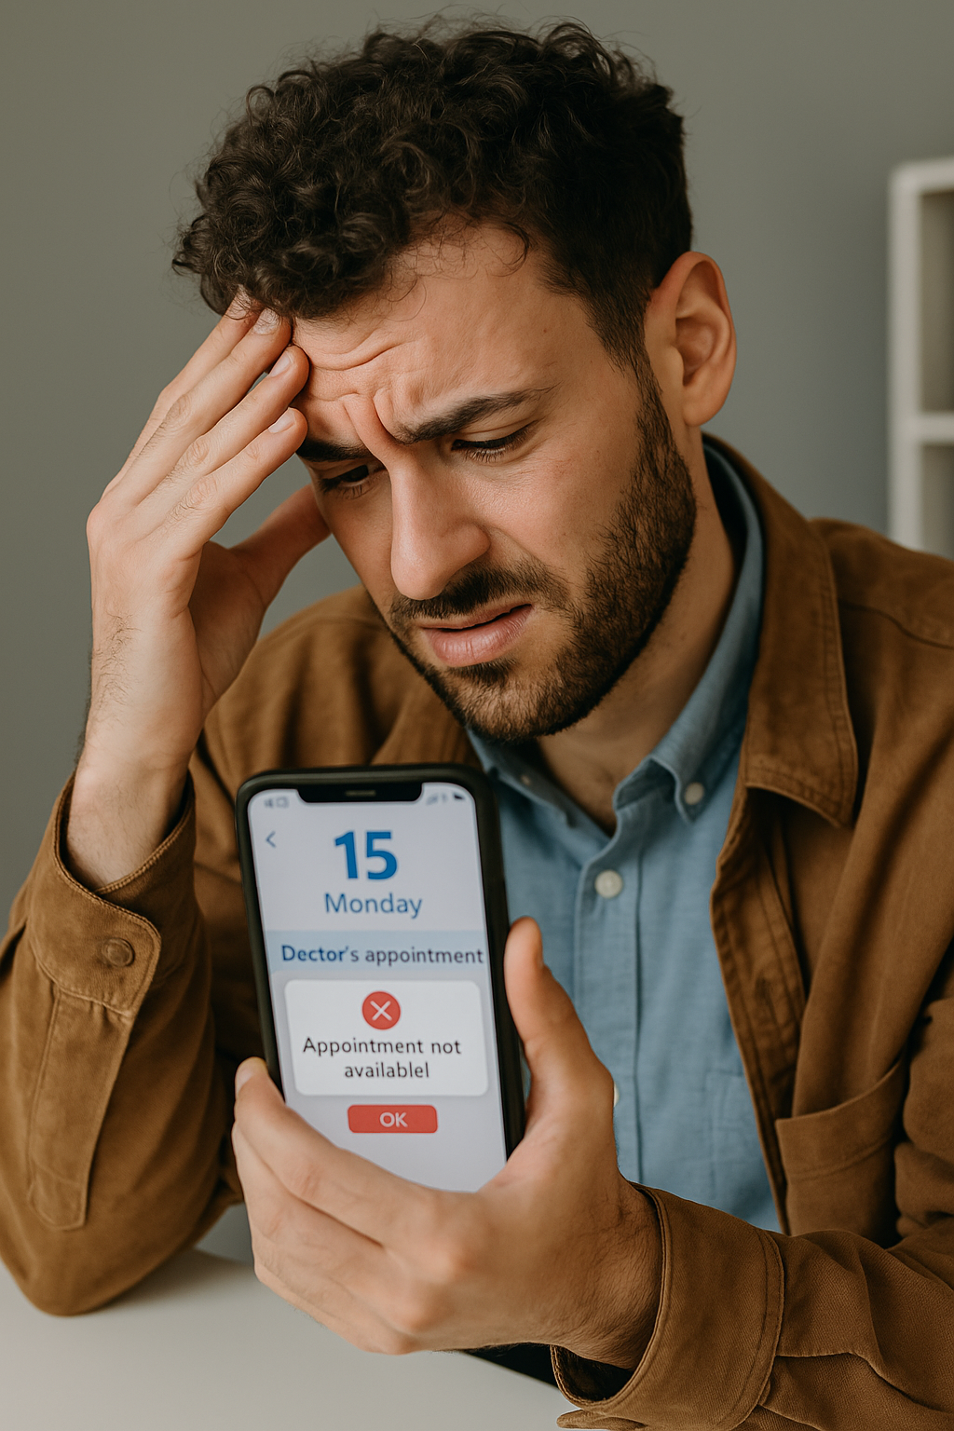


MediPulse
Why MediPulse?

Slide 5




Medipulse
Team
Mohamed Ziad
Mohamed Ahmed
Mohamed Osama
UI/UX
Application
Full-stack

Slide 6



Medipulse
Team
Mohamed Yousry
Omar sherif
Abdelrahman
Ahmed
AI
Security
Database

Slide 7


Medipulse
Team
Ramez Gomaa
Mohamed
Ramadan
Front-end
Security

Slide 8
Medipulse
Team
M
S
A
Mariam Fathy
Salma Emad
Abeer Samir
UI/UX
Application
Database

Slide 9


MediPulse Database Build
At the beginning of the project, our focus was on collecting and organizing essential medical data to power the platform.

Slide 10

MediPulse
Collecting The Data
We used manual data collection techniques to gather verified information from trusted medical websites and directories, including :
Specialties.
Work locations (clinics/hospitals).
Cities.
Contact details.
Patient reviews (if available).

Slide 11
MediPulse
How we Preprocessed the data
Once the data was collected, we proceeded with:
Cleaning and transforming the data into structured formats (Excel).
Designing the initial database schema.
Defining relationships between core entities (e.g., doctors, patients, appointments).

Slide 12



Technologies and Tools
MySQL Server
Microsoft Excel
Lucidchart
SQL database management
Data import/export and preprocessing
Diagrams (ER, Sequence, Use Case )
04

Slide 13
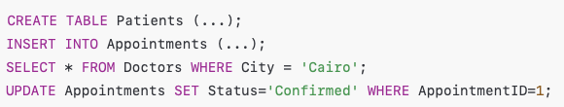
Sample SQL Code

Slide 14
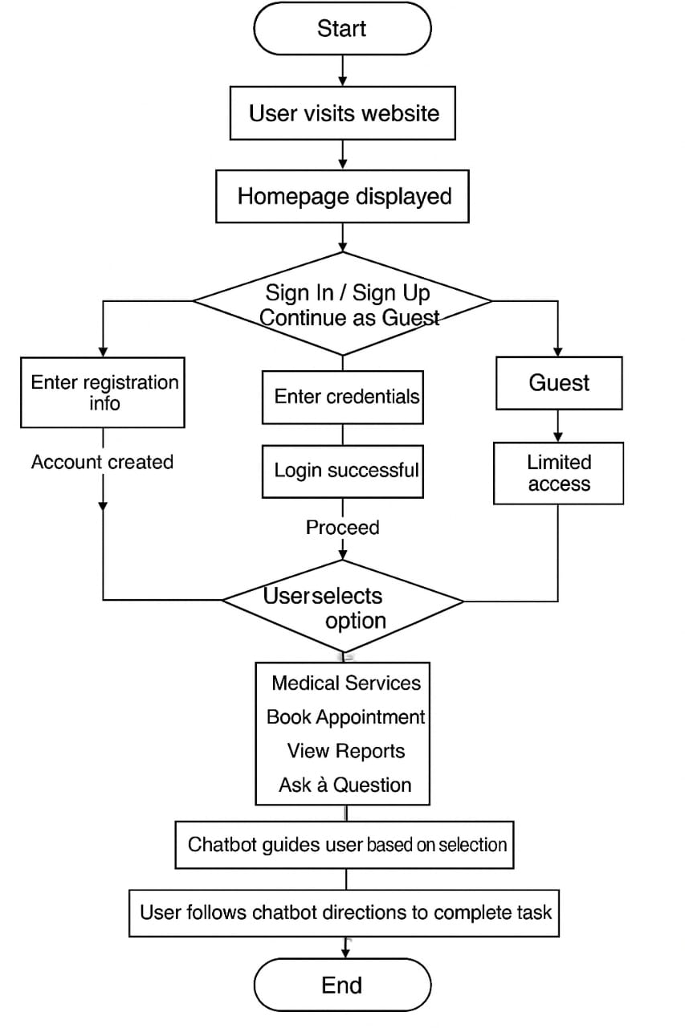
Flowchart

Slide 15
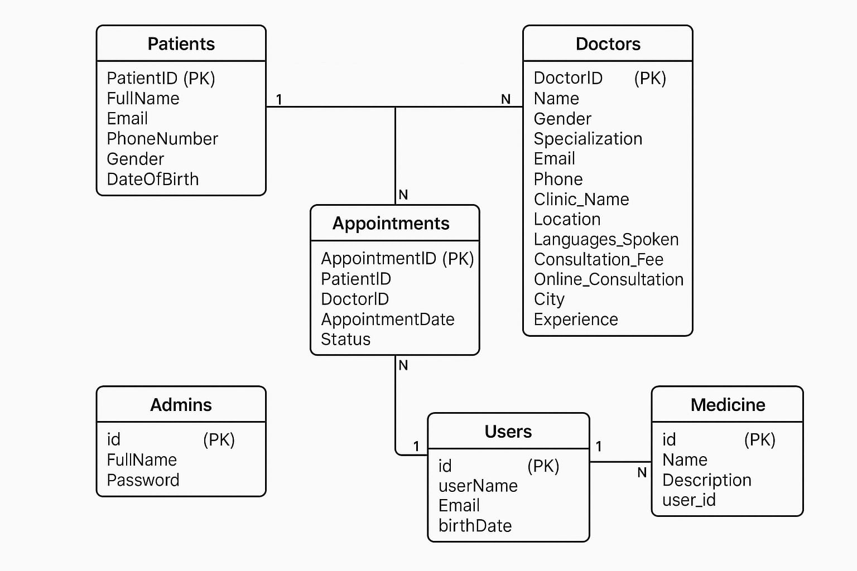
MediPulse
ER Diagram

Slide 16
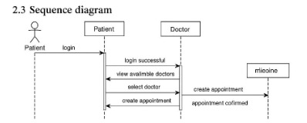
MediPulse
SEQUENCE
Diagram

Slide 17



From Queries to Action
To bring MediPulse to life, we connected our MySQL database to the backend using phpMyAdmin as our interface for managing data operations.
Perform queries and updates triggered by user actions.
Send and retrieve data (e.g., doctor profiles, appointments, user accounts).
Maintain database structure with tables, relationships, and keys.
Support secure authentication and session handling.

Slide 18
Frontend –
The User Experience Layer

Slide 19

Medipulse
The frontend is what users see and interact with directly.
Designed for a smooth, fast, and responsive experience.
Handles user actions like clicks, form inputs, and navigation.
Presents backend data in a clean, organized interface.
Built with a focus on:
Responsive Design (works across all devices)
Reusable & Maintainable Code
Visual Clarity & Accessibility

Slide 20



Medipulse
Technologies Used
Framework & Routing
React.js
React Router
State Management
Redux Toolkit
Styling
Tailwind CSS API Integration
Axios

Slide 21




Medipulse
Backend: The Engine Behind MediPulse
Core Services
The backend handles core operations like user login (including Google), managing doctor and patient data, booking appointments, processing searches (e.g., by specialty or city), and collecting feedback.
Integration
Powers chatbot interactions, supports medical product purchases, and securely connects to the frontend through APIs.

Slide 22
Medipulse
Technologies Used
Core Framework
Node.js.
Express.js.
Database.
MySQL
Authentication
JSON Web Token (JWT)
Bcrypt
API Development
RESTful Principles
Nodemon

Slide 23
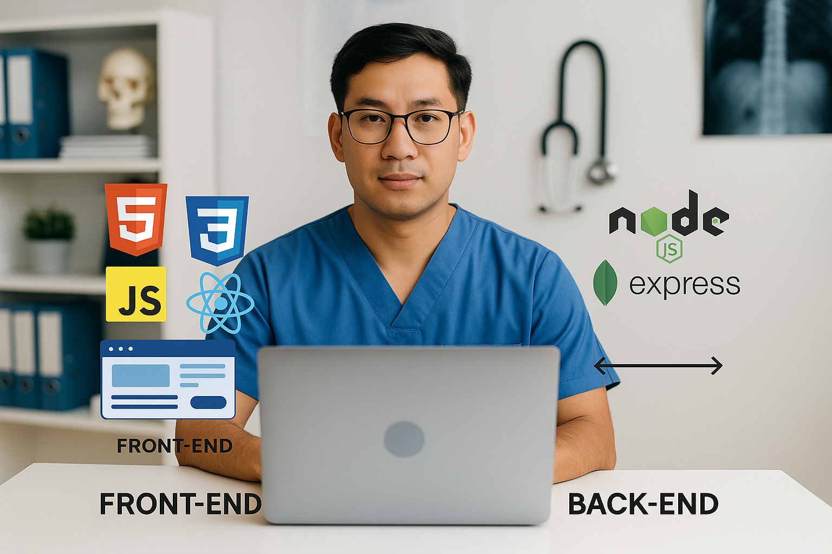
Medipulse
System Architecture – MVC Pattern

Slide 24
Medipulse
Model (M)
Handles the structure, storage, and retrieval of key entities like patients, appointments, chatbot conversations, and medical records within the database.

Slide 25
Medipulse
View (V)
The user-facing layer that presents data from the backend and enables actions like booking appointments or chatting with the AI assistant, ensuring a clear, responsive, and interactive user experience.

Slide 26
Medipulse
Controller (c)
Serves as the middle layer that processes user requests from the frontend, validates inputs, interacts with AI services, accesses data models, and returns appropriate responses to ensure smooth system operation

Slide 27
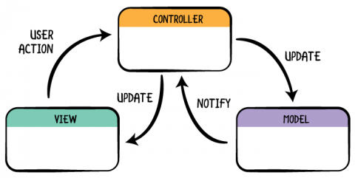
Medipulse

Slide 28
Medipulse
Features
User Access
Supports authentication, authorization, and Google login for users.
Doctor & Appointment Management
Allows users to book/manage appointments and lets doctors register to join the directory
Advanced Search
Enables patients to find doctors by specialty, city and facility

Slide 29
Medipulse
User Engagement
Includes doctor reviews and a contact form for feedback or inquiries.
E-Commerce
Allows users to browse and purchase medical products and medications.
Language Accessibility
Enables patients to find doctors by specialty, city and facility

Slide 30
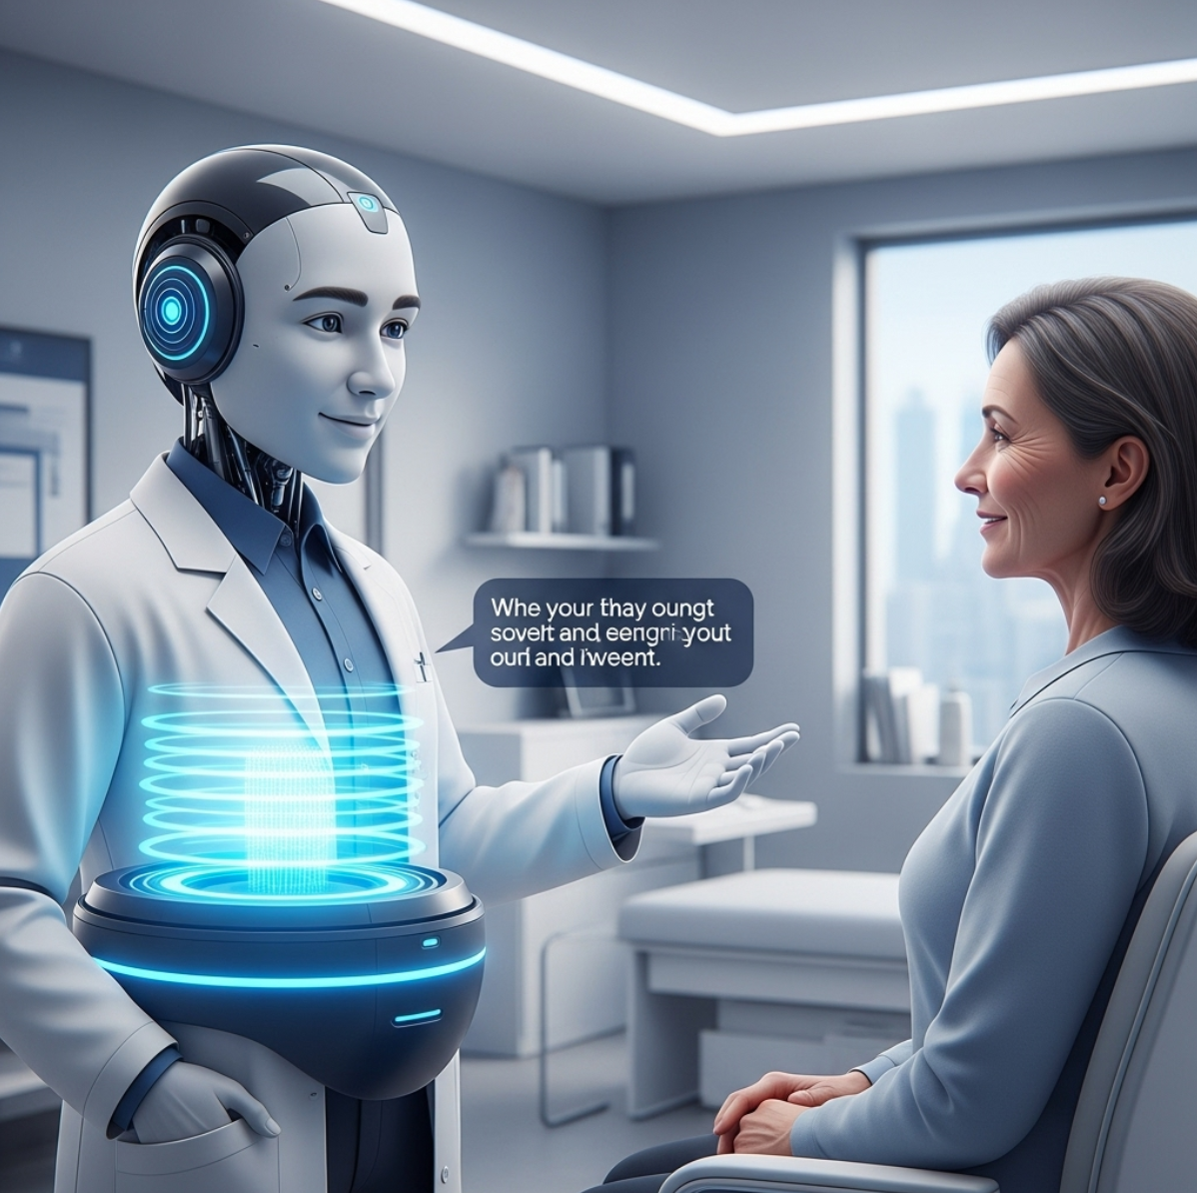

Medipulse
MediPulse AI
Chatbot
Real Conversation. Safe Guidance

Slide 31


Medipulse
The Problem
We Saw
Many people search online when feeling unwell. But the information is often inaccurate, scary, or misleading. There’s no system that truly understands their language or personal context.

Slide 32

Medipulse
Our Goal
To provide safe, early-stage medical information in the user's language, based on structured inputs, not assumptions — without giving diagnoses.

Slide 33
Medipulse
How the MediPulse Chatbot Works
Asks structured questions
(e.g., age, smoker, conditions).
Understands context before responding.
Then lets the user describe symptoms.
Returns safe, general health info only. (No diagnosis, no prescriptions)

Slide 34


Prompt
Backend
MediPulse v4.2 – strict safety
Python Flask API
Architecture
LLM
API
LLaMA3 70B
RESTful API (web & mobile)

